Slide 1
Vehicle trajectory tracking in traffic system
Thanh Hung Duong

Slide 2
What is vehicle trajectory tracking
Intelligent vehicles
Recognize the driving environments
Realize its longitudinal control
Guide the vehicle along reference trajectories
Trajectory tracking is one of the basic ability of intelligent vehicle,
Aiming to complete the scheduled tasks safely and effectively.
Trajectory tracking control means tracking reference trajectories scheduled or given by path planners
→ Mostly for lane changing or curve road

Slide 3
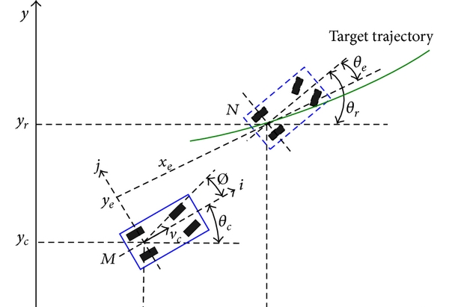
Vehicle Kinematics
Due to the directionality of the vehicle motion, the vehicle’s position and orientation are described by two independent coordinates, which are world coordinate system Oxy and local coordinate system Mij

Slide 4
Controller design
The intelligent vehicle has the nature of nonholonomic constraint feature because the number of system inputs is less than the number of system outputs or system states.
Lots of control methods are applied to control the nonholonomic systems, for example, linear feedback [21], fuzzy logic [22], variable structure [23], neural network [24], and so on [25].
There have no absolutely more predominant scheme than the others to resolve the nonholonomic problems presently though each of the control methods has advantages and disadvantages.

Slide 5
Dataset
Berkeley DeepDrive:
the largest driving video dataset to date supporting heterogenous multi-task learning
100,000 HD video sequences of over 1,100-hour driving experience across many different times in the day, weather conditions, and driving scenarios.
Waymo open dataset:
high resolution sensor data collected by Waymo self-driving cars in a wide variety of conditions.
More : https://analyticsindiamag.com/top-10-popular-datasets-for-autonomous-driving-projects/

